Slide 1

Java for Beginners
Level 3
Mr. Teasdale

Slide 2
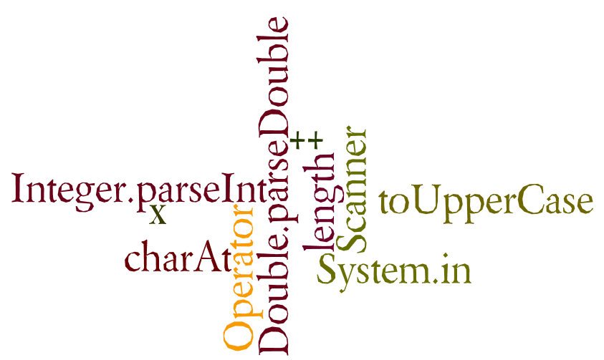
What do you learn last time?
Wordle.org

Slide 3
Levels of Java coding
1: Syntax, laws, variables, output
2: Input, calculations, String manipulation
3: Selection (IF-ELSE)
4: Iteration/Loops (FOR/WHILE)
5: Complex algorithms
6: Arrays
7: File management
8: Methods
9: Objects and classes
10: Graphical user interface elements

Slide 4
Four and ½ steps to keyboard input
Import java.util.* BEFORE main()
Declare a Scanner
Declare a String variable to catch input
Use the Scanner to assign input from keyboard to variable
Convert to int/char/double (if necessary)
import
Scanner
(String) variable
readLine()

Slide 5
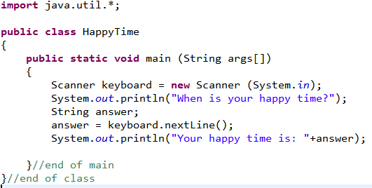
Keyboard input

Slide 6
Calculations in Java
Operator | Function | Example | Result
+ | Add | int i = 10 + 2; | 12
- | Subtract | int j = i – 3; | 9
/ | Divide | double k = j / 3; | 3.00
* | Multiply | int product = i * j; | 108
++ | Add 1 | i++; | 13
-- | Subtract 1 | j--; | 8
% | Modulus | int m = 12 % 5; | 2

Slide 7
String methods
There are many functions we can use to manipulate Strings. They are called the ‘String methods’
Method | Function | Example
.charAt(x) | returns the char from a specified index | String colour = “blue”; char letter = colour.charAt(0);
.toUpperCase() | returns the String in UPPER CASE | String name = “bob”; bob = bob.toUpperCase();
.toLowerCase() | returns the String in lower case | String pet = “DOG”; pet = pet.toLowerCase();
.subString(x,y) | returns String portion between two indexes | String s = “I love hats”; String snip = s.substring(2,6);
.length() | returns how many characters there are in a String | String h = “radar”; int size = h.length();

Slide 8
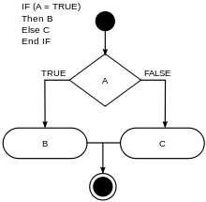
IF (condition)
Used to change the flow of an algorithm, dependent on a condition.

Slide 9
if(condition)
Condition is a logic check
something OPERATOR something
Example:
if(num == 3)

Slide 10
Logic operators in Java
Operator | Function | Example
= = | equals (int, double, char, boolean) | if(num==3)
.equals() | equals (String) | if(name.equals(“Chris”) )
> | greater than | if(num>20)
< | less than | if(num<15)
>= | greater than or equal to | if(age>=18)
<= | less than or equal to | if(age<=12)
!= | not equal to | if(married!=true)
Warning! = does not mean ==

Slide 11
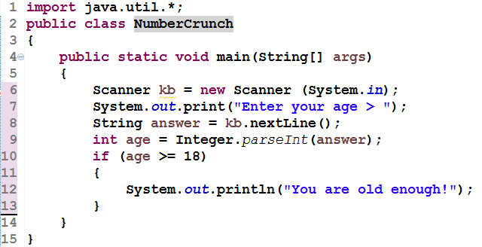
IF example (int comparison)

Slide 12
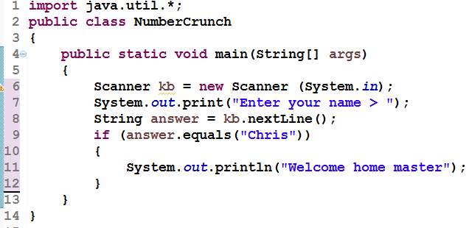
IF example (String comparison)

Slide 13

What students struggle with
= and ==
.equals(“xx”) for Strings
Putting a ; at the end of if( xx)
if(num > 3); ✗
if(num > 3) ✓

Slide 14
IF/ELSE (2 outcomes)

Slide 15
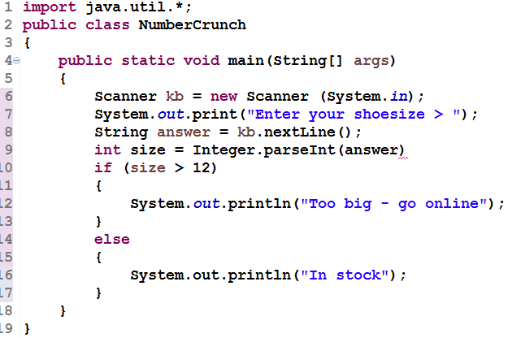
IF/ELSE (int example)

Slide 16
Note conditions
if (condition)
{
something
}
else
{
something else
}
if (condition)
{
something
}
else if (condition)
{
something else
}
else
{
third option
}
Only IF gets a condition
ELSE does not

Slide 17
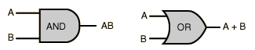
AND/OR
AND in Java: &&
OR in Java: ||
Used between conditions
if(num>3&&<12) ✗
if(num>3)&&(num<12)✓

Slide 18
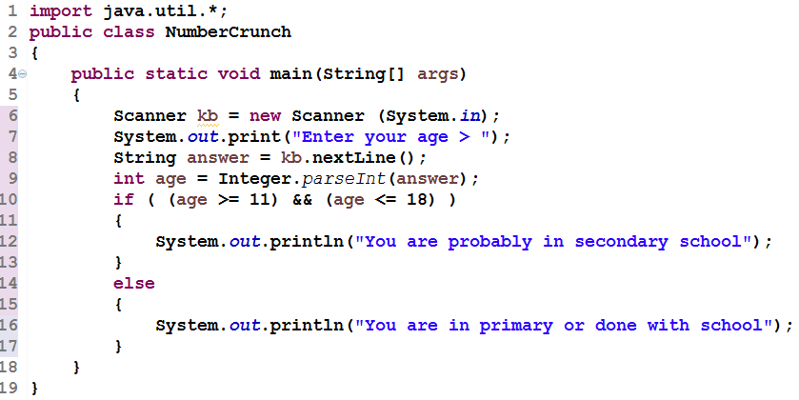
IF/ELSE (int example with AND)

Slide 19
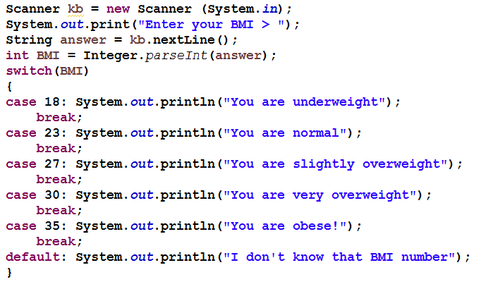
Switch/Case (IF alternative)

